Slide 1


Replication: Incorporating Multiple Linear Regression in Predicting House Price.
Caoimhe Ni Mhaonaigh
11th April 2022

Slide 2
Quote Slide Option 2
The Study
The data: “AmesHousing.csv” 80 explanatory variables used to predict house price in Iowa USA.
The methodology:
Random Forest for best predictors.
Highly correlated dropped
Assumptions of linear regression checked.
The findings: R squared: 0.9283 (RSE= 0.94) (RMSE=0.12792)
Conclusion: “Results show that multiple linear regression can precisely predict the house prices with big dataset and large number of both categorical and numerical predictors”.

Slide 3
The Replication
Replaced NA’s with mean
Log transformation
Highly correlation features
Random forest
Multiple linear regression

Slide 4
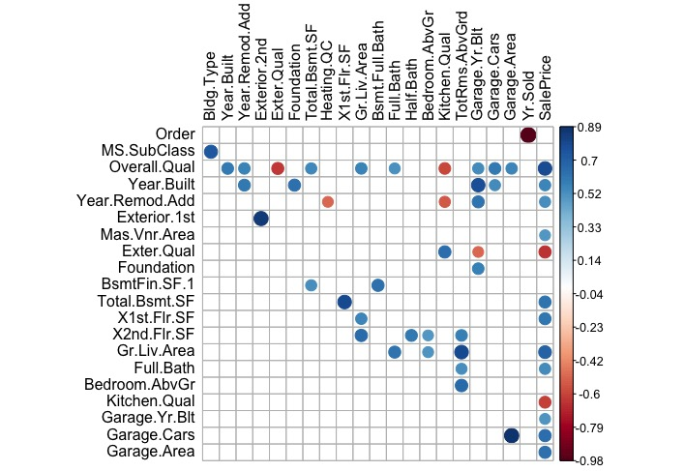
3: Highly Correlated Features
The study goes on to include 5 of these variables in the Multiple Linear Regression.
Plot showing features with a Correlation of over 0.5

Slide 5
4.1: Random Forest
Random forest using the unprocessed data

Slide 6
4.2: Random Forest
This now takes into account the assumptions of Linear Regression.
Linearity
Homoscedastic
Independence
Random forest using the processed data

Slide 7
5: Multiple Linear Regression
Model using the top 12 Features of the Random Forest
and all the categories of the categorical variables
Zipped Groups

